Slide 1

Modeling Lithium Extraction from Produced Water with ePC-SAFT 03/18/2026 Tanner Polley

Slide 2
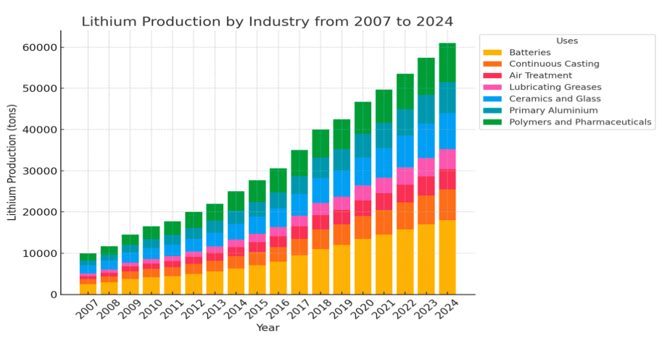
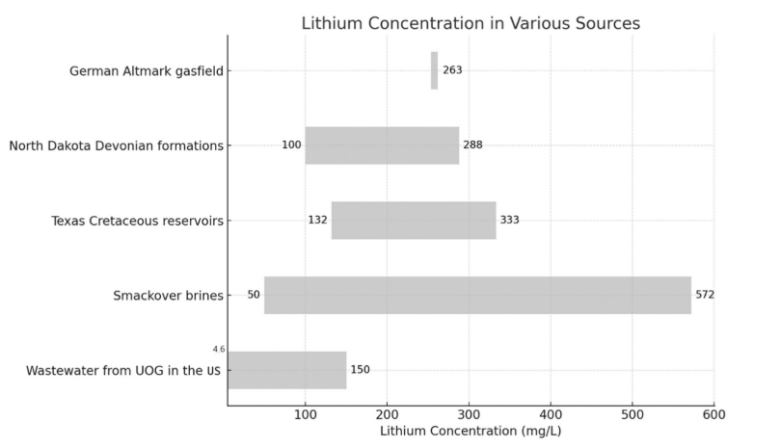
Extract Lithium from Produced Water to Meet Demand
Global lithium demand is projected to exceed 2.5 million metric tons LCE by 2030, driven largely by EVs and grid-scale storage.
Produced water from oil and gas wells can contain lithium from under 10 mg/L to over 600 mg/L, representing significant untapped potential.
Because produced water chemistry varies widely, only some wells are strong candidates; identifying high-lithium, low-interference sweet spots is key.
Recovering lithium from produced water offers two benefits: helping meet demand and reducing disposal costs for oil and gas operators.
Notes:
References:
(1) Almousa, M.; Lim, Y. H.; AlMubaidin, M.; Alshami, A.; Al-Tayyem, B. H.; Tomomewo, O.; Khalifa, H. Comparative Feasibility of Lithium Extraction Technologies in U.S. Oilfields. Desalin. Water Treat. 2025, 322, 101128. https://doi.org/10.1016/J.DWT.2025.101128.

Slide 3
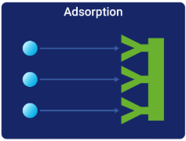
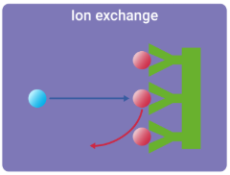
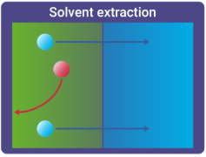
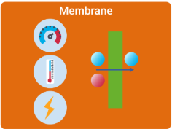
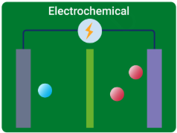
Direct Lithium Extraction (DLE) Technologies
DLE technology | Main idea | Pros | Cons
Adsorption | Li captured on solid sorbents | Mature Selective Scalable | Brine-specific Pretreatment Sorbent fouling
Ion exchange | Li swaps onto ion-sieve solids | Selective High recovery Concentration boost | Sorbent degradation Acid regeneration Cost
Solvent extraction | Li transferred into organic phase | Low Operating Cost Efficient and Selective Continuous | Solvent loss Safety risk Water use
Membranes | Li separated through selective membranes | Modular Lower reagents Smaller footprint | Fouling Li/Na selectivity Durability
Electrochemical | Li moved by electric field/redox cells | High selectivity Low chemicals Fast response | High power demand Electrode degradation Scale-up
Notes:
References:
https://lithium.org/wp-content/uploads/2024/06/Direct-Lithium-Extraction-DLE-An-introduction-ILiA-June-2024-v.1-English-web.pdf
https://www.idtechex.com/en/research-report/direct-lithium-extraction/1140

Slide 4
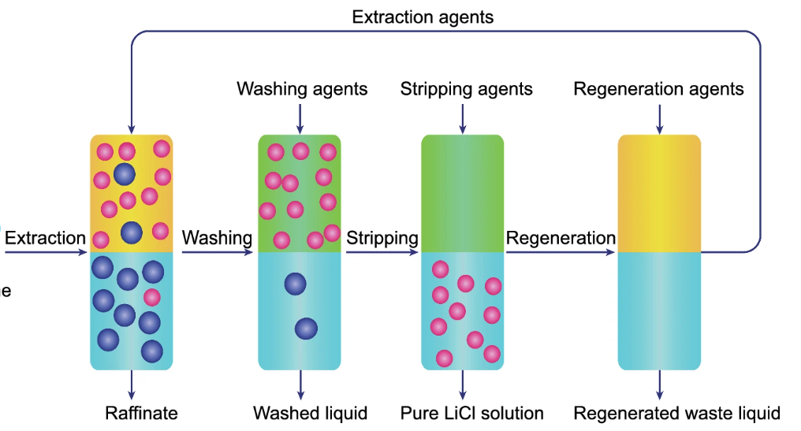
Why Solvent Extraction of Lithium?
Strengths:
Effective for dilute, low-quality brines and produced water where evaporation-based methods are impractical
High lithium selectivity can outperform many alternatives in complex brines with competing ions
Enables staged impurity removal and lithium recovery within the same process
Lower energy demand than evaporation and can reduce downstream concentration requirements
Extractants can often be stripped and reused, supporting continuous operation and product recovery
Weaknesses:
Selectivity can still drop in the presence of high concentrations of multivalent ions or organics
Requires organic solvents/extractants, creating solvent-loss, handling, and environmental concerns
Many systems remain formulation-sensitive and not yet fully proven at large commercial scale
Requirements:
A thermodynamic model to predict the activity of each compound in each phase which determines the distribution coefficient of transfer
Notes:
Transition:
Solvent Extraction Physics relies on being able to predict the liquid-liquid equilibrium of all the ionic compounds and solvents of a given mixture
A model must be used to predict the
(23) Kanagasundaram, T.; Murphy, O.; Haji, M. N.; Wilson, J. J. The Recovery and Separation of Lithium by Using Solvent Extraction Methods. Coord. Chem. Rev. 2024, 509 (December 2023), 215727. https://doi.org/10.1016/j.ccr.2024.215727.

Slide 5
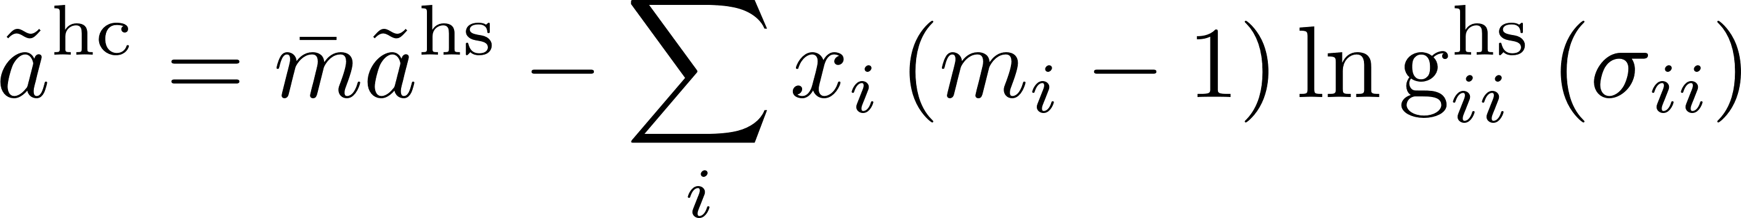
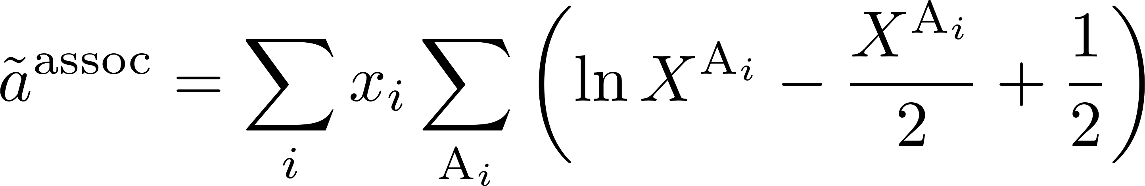
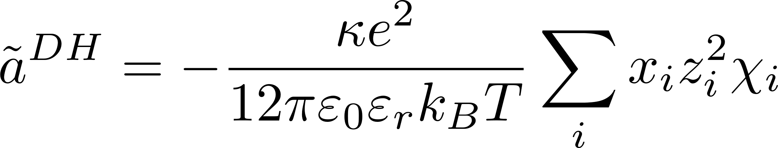
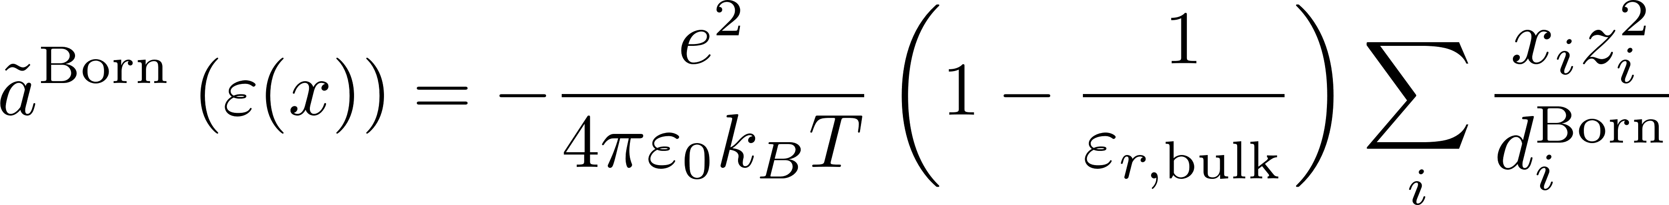
What is ePC-SAFT ?
Total Residual Helmholtz Energy
Hard-chain
Represents excluded volume plus chain connectivity
Dispersion
Represents non-specific attractive van der Waals interactions between segments
Association
Represents short-range, site-specific interactions such as hydrogen bonding
Debye–Hückel
Represents long-range ion-ion electrostatic screening
Born
Represents ion solvation in a dielectric medium
ePC-SAFT (electrolyte Perturbed-Chain Statistical Associating Fluid Theory) is an equation of state that can predict the phase behavior of almost any system, including complex electrolyte systems
Unlike activity coefficient models, ePC-SAFT is built on a molecular foundation via statistical mechanics.
The main advantage it has is the significantly reduced amount of fitted parameters for specific mixtures while maintaining or even improving in accuracy.
It relies only on pure-component fitted parameters and one set of binary interaction parameters
All relevant thermodynamic properties are derived from the total residual Helmholtz energy which is the sum of the individual contributions
Notes:
(1) Yu, G.; Li, Y.; Zhang, X.; Jovein, I. B.; Figiel, P.; Chen, B.; Ji, Y.; Sadowski, G.; Held, C. Lithium Extraction from Salt-Lake Brines Using Dicationic Ionic Liquids: EPC-SAFT Modeling and Molecular Mechanisms. AIChE J. 2025, 71 (April), e18907. https://doi.org/10.1002/AIC.18907.

Slide 6



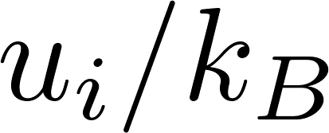

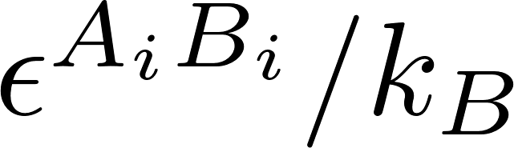
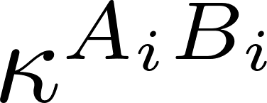
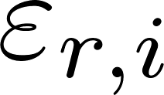
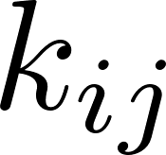
ePC-SAFT Parameters
 | Name | Units | Description | Purpose
 | Segment number | - | Number of PC-SAFT segments used to represent component i. | Sets chain length and coarse-grained molecular size.
 | Segment diameter |  | Temperature-independent segment diameter of component i. | Sets the molecular size and packing length scale.
 | Dispersion energy parameter |  | Segment energy parameter for non-specific attractive interactions. | Sets the strength of van der Waals-type attraction between segments.
 | Association energy | - | Site-specific association energy between sites on component i. | Sets the strength of hydrogen-bonding or other specific association interactions.
 | Association volume | - | Effective association volume for the bonding sites on component i. | Sets the geometric probability or bonding volume for association.
 | Relative Permittivity | - | Pure-component relative permittivity used to represent the dielectric response of the component | Debye-Huckel; Born
 | Binary interaction parameter | - | Unlike-pair binary interaction parameter used in the dispersion combining rule | Tunes unlike-species energetic interactions when the default mixing rule is not sufficient.

Slide 7
C++ to Python based ePC-SAFT Package
ePC-SAFT Package was originally inherited from an existing repo
It is built has a Python package, but the internals are built in C++ and the two are connected through Cython
This minimizes calculation time which is necessary since there can be many internal solves
Major improvements have been made from this base package
Added concentration dependent dielectric constant capabilities
Robust dielectric constant models can be used
Added the most up to date 2025 ePC-SAFT version which is not present in any PC-SAFT package distribution
Vastly improved the workflow to include custom parameters for complex mixtures

Slide 8
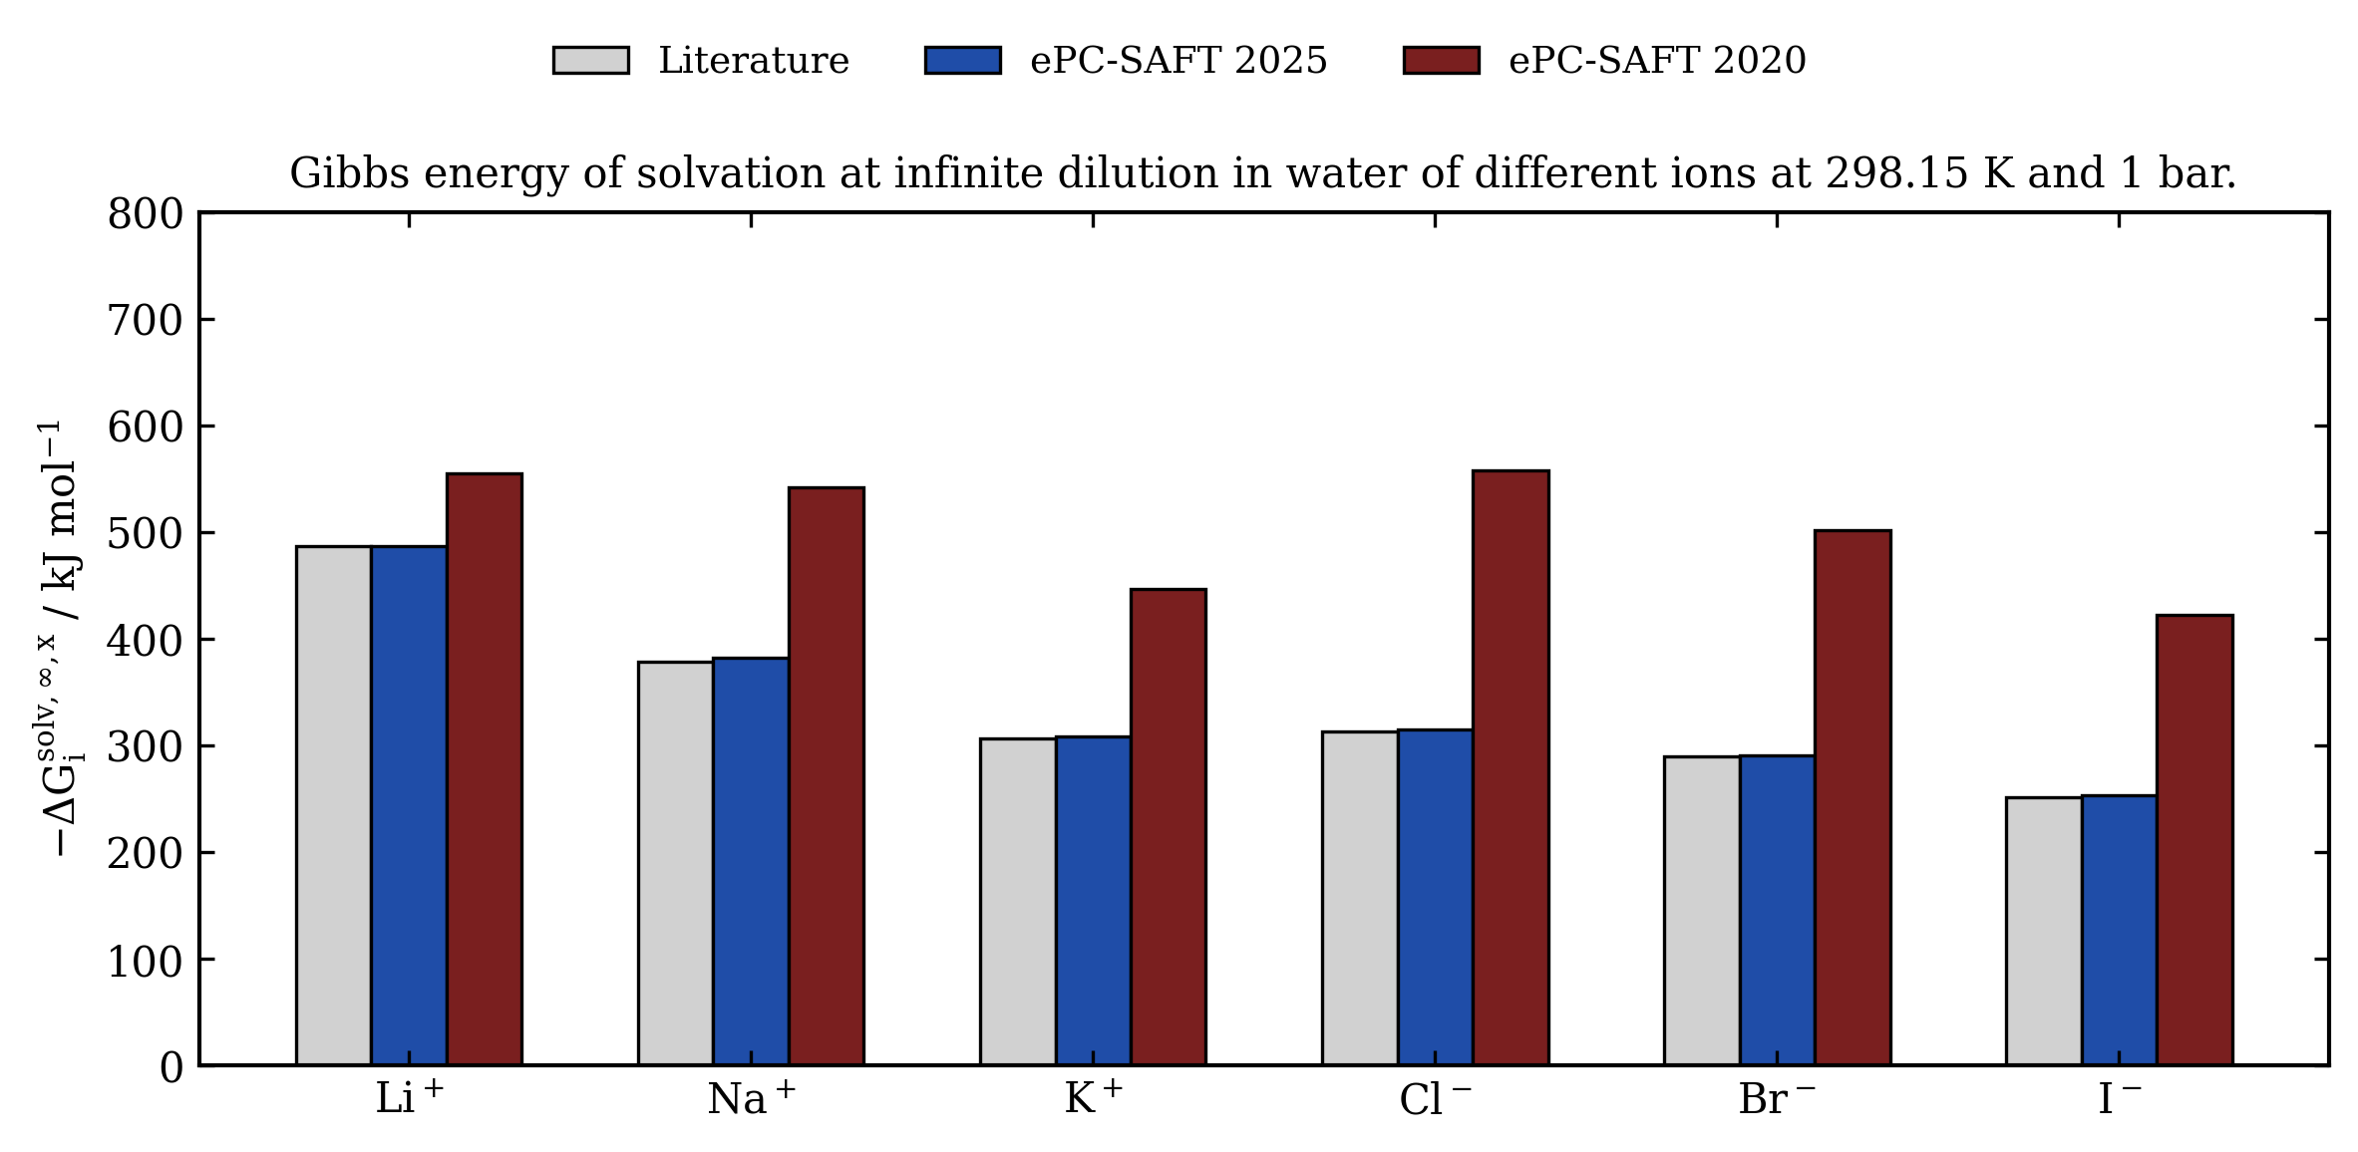
ePC-SAFT Model Validation – Energy of Solvation
The 2025 ePC-SAFT model improves ionic solvation by extending the Born term with a solvation-shell model and dielectric saturation, so the local solvent environment around an ion is no longer treated as a uniform bulk dielectric. This gives a more physical description of strong ion solvation, especially for small and highly charged ions, and improves agreement with hydration and transfer free energies.

Slide 9
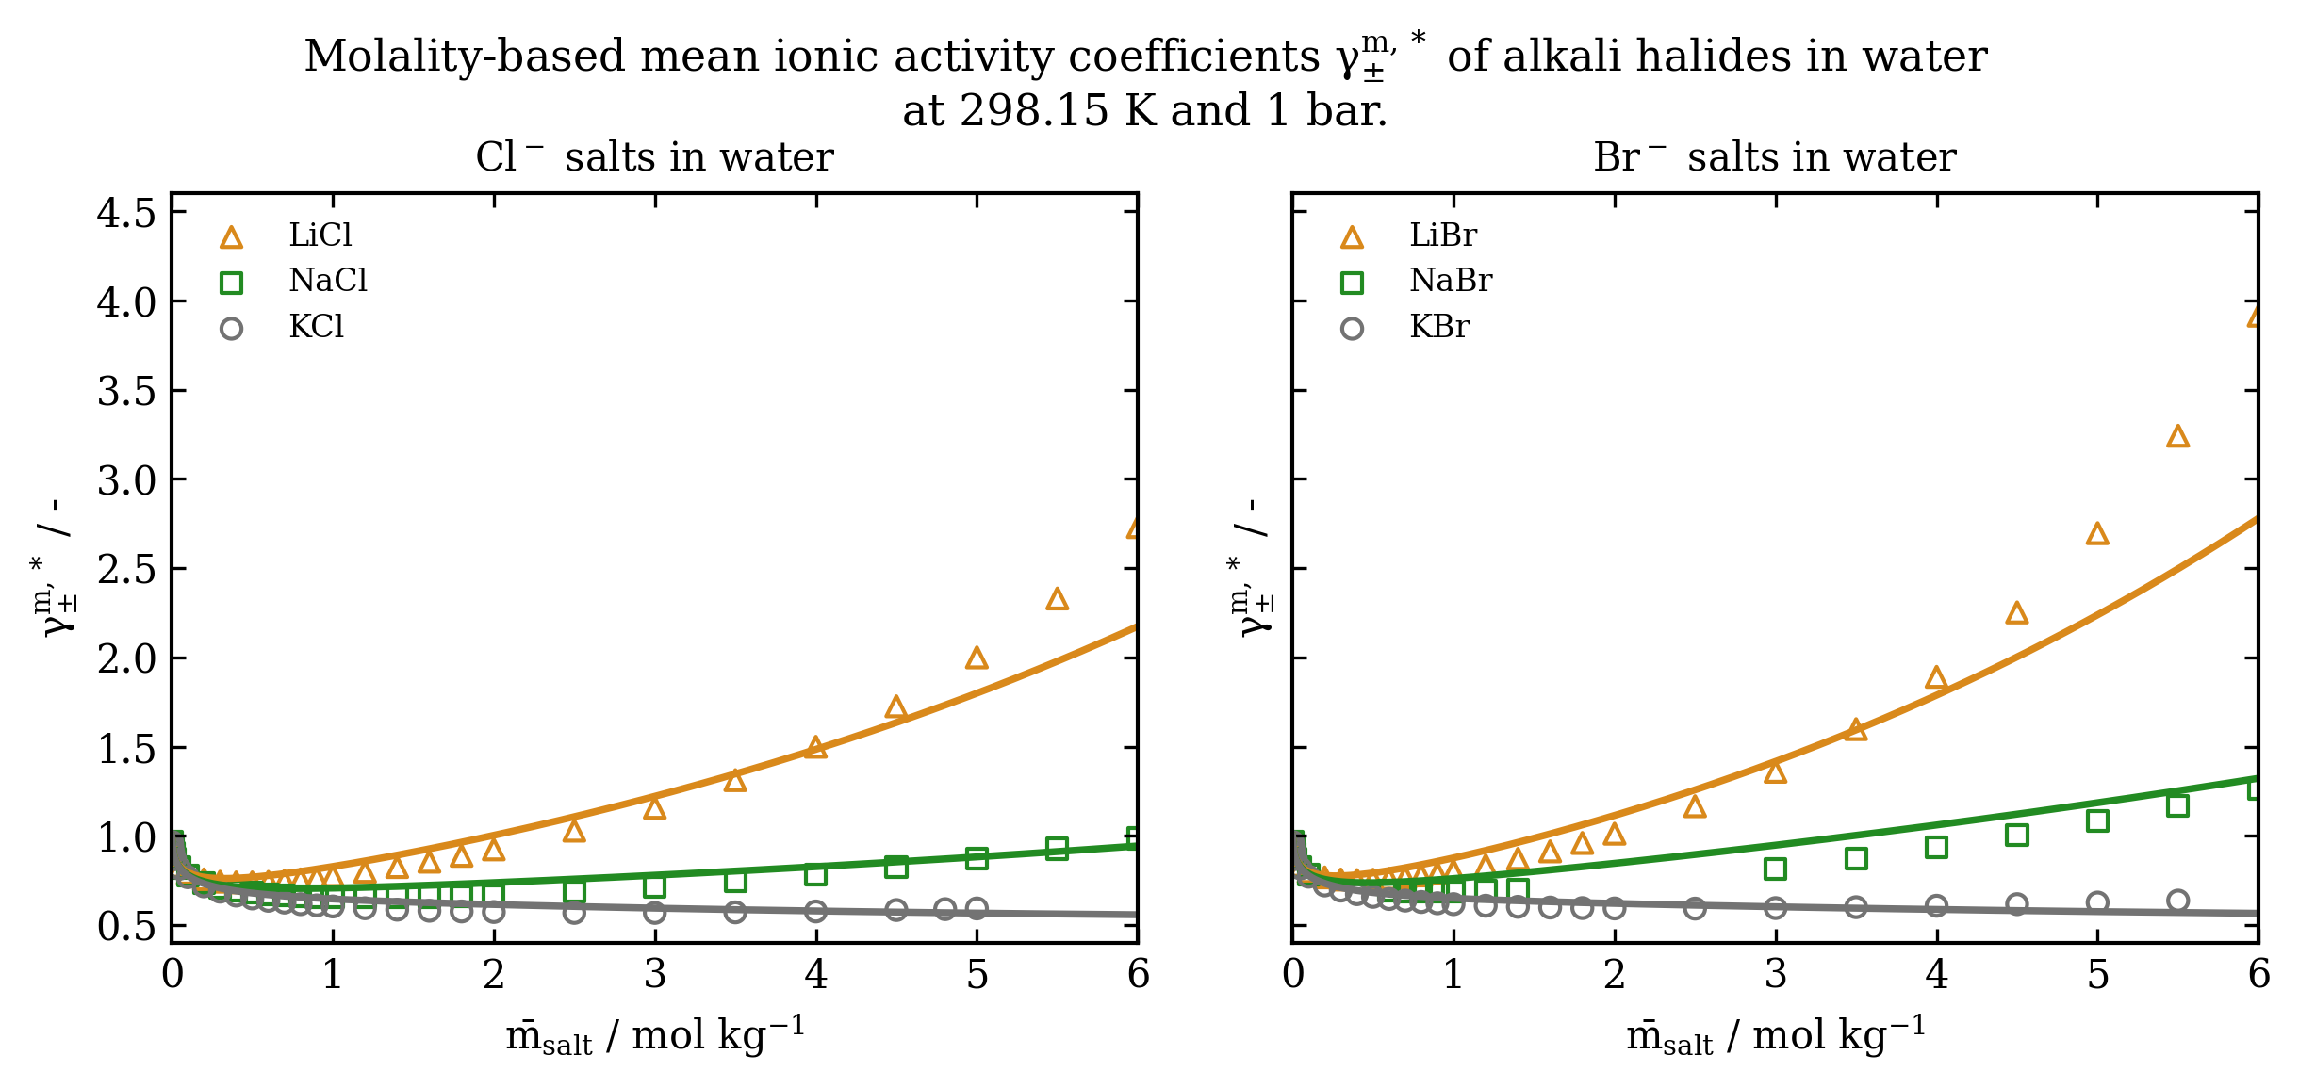
ePC-SAFT Model Validation – Salt activity in water

Slide 10
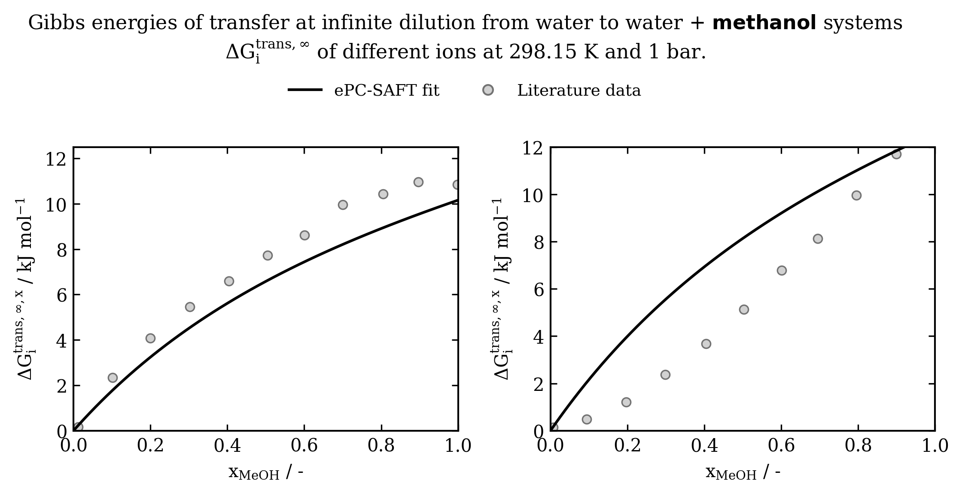
ePC-SAFT Model Validation – Energy of Transfer

Slide 11
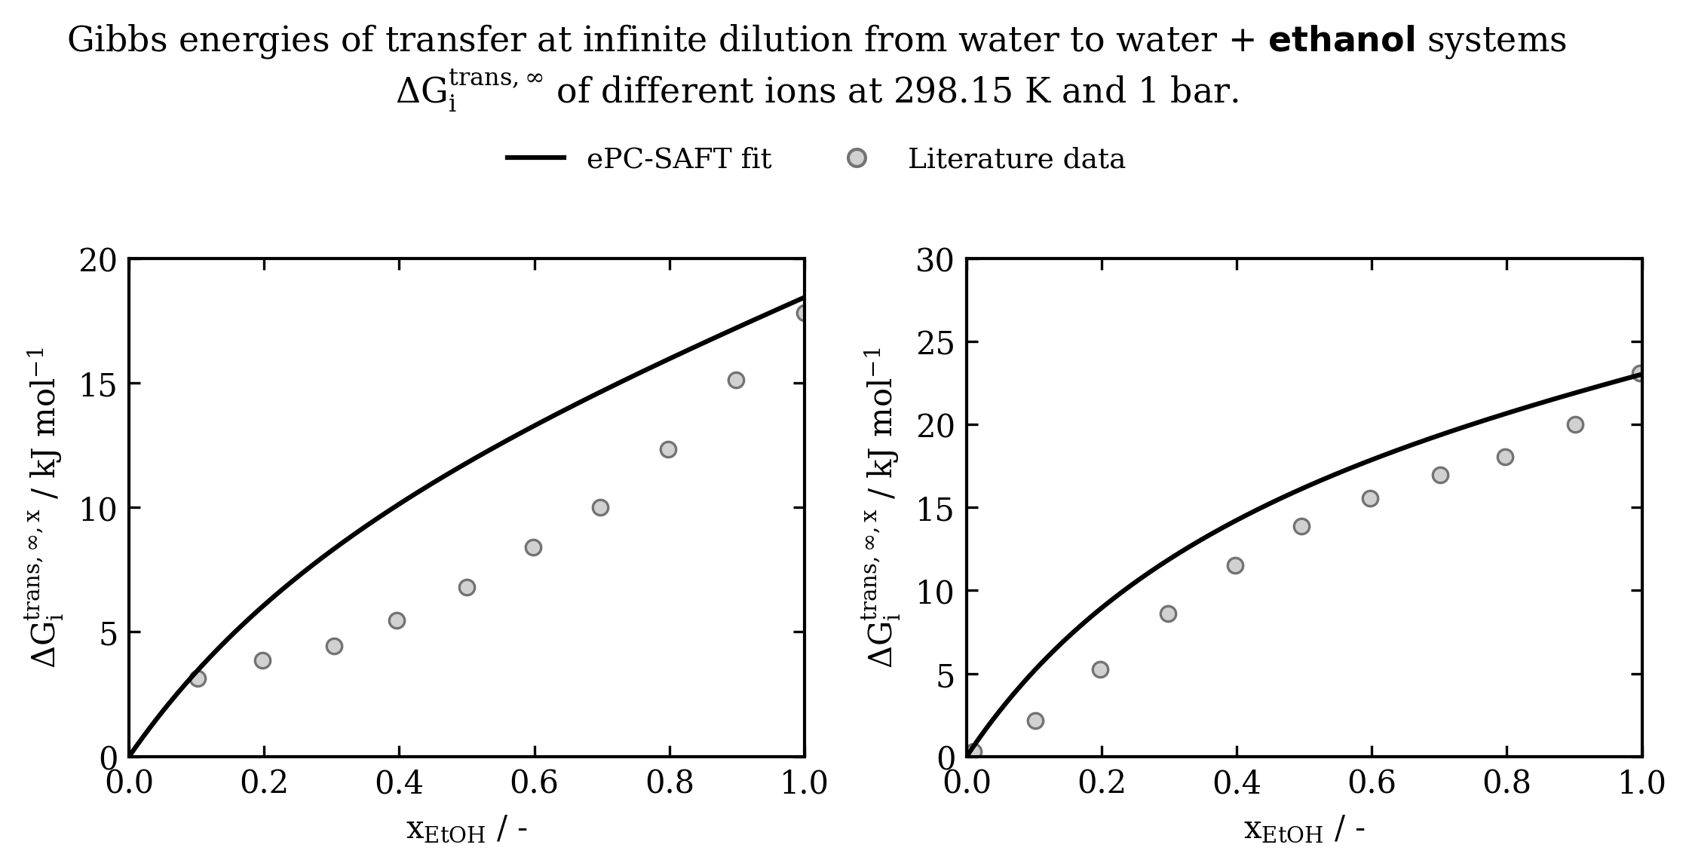
ePC-SAFT Model Validation – Energy of Transfer

Slide 12
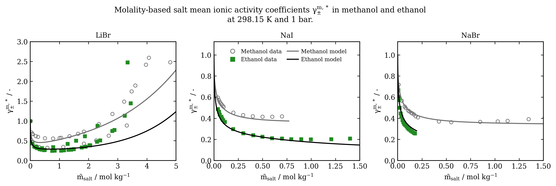
ePC-SAFT Model Validation – Activity in organics

Slide 13
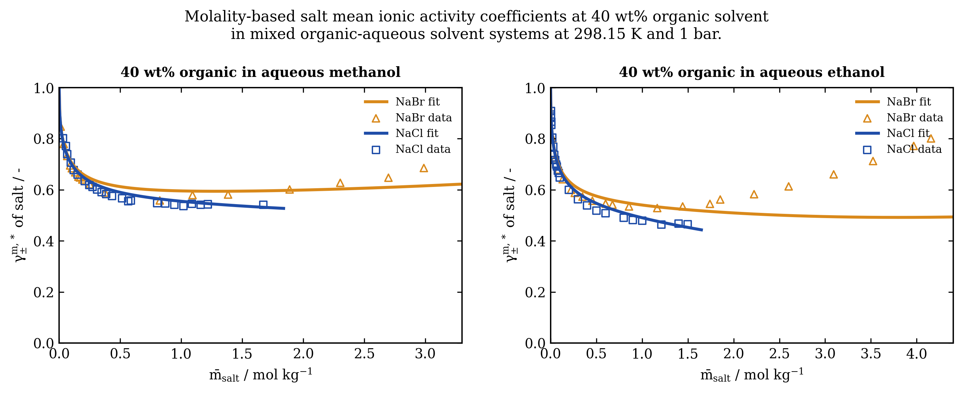
ePC-SAFT Model Validation – Mixed solvents

Slide 14
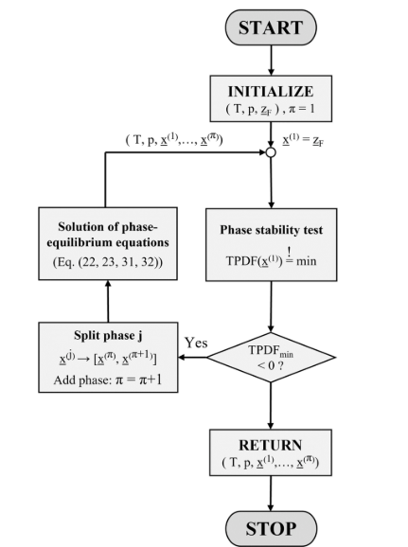
Included Multi-phase Equilibrium Algorithm
Starts from a specified T, P, and overall feed composition, then checks whether one liquid phase is thermodynamically stable by using the TPDF function, which measures whether a trial phase would lower the system Gibbs free energy relative to the current phase: a negative minimum TPDF means the current phase is unstable and phase splitting is favorable.
If instability is detected, solves for the phase compositions and phase fractions that satisfy equilibrium constraints simultaneously: equal fugacity for neutral species, equal mean-ionic fugacity for salts/ions, overall mass balance, and phase electroneutrality.
Repeats stability testing and equilibrium solving until all phases are stable and the residuals are small, giving a self-consistent multiphase solution with physically meaningful phase compositions and splits.

Slide 15
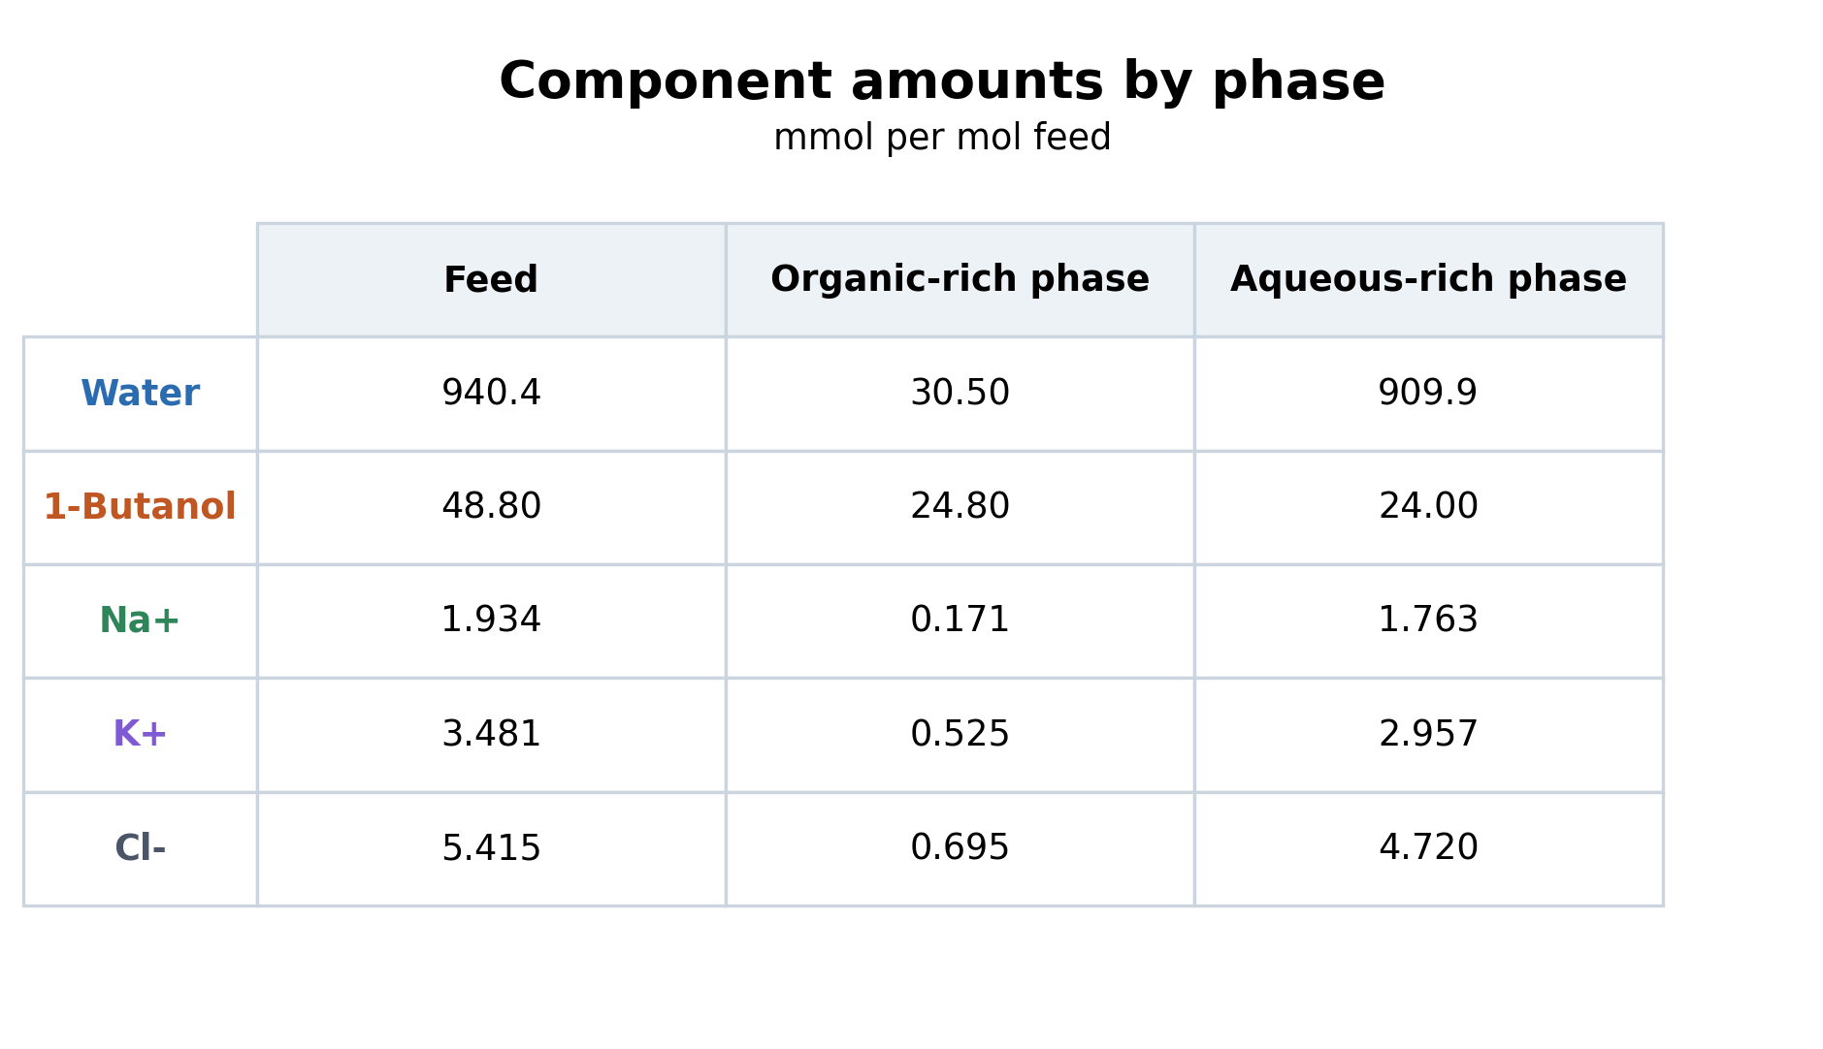
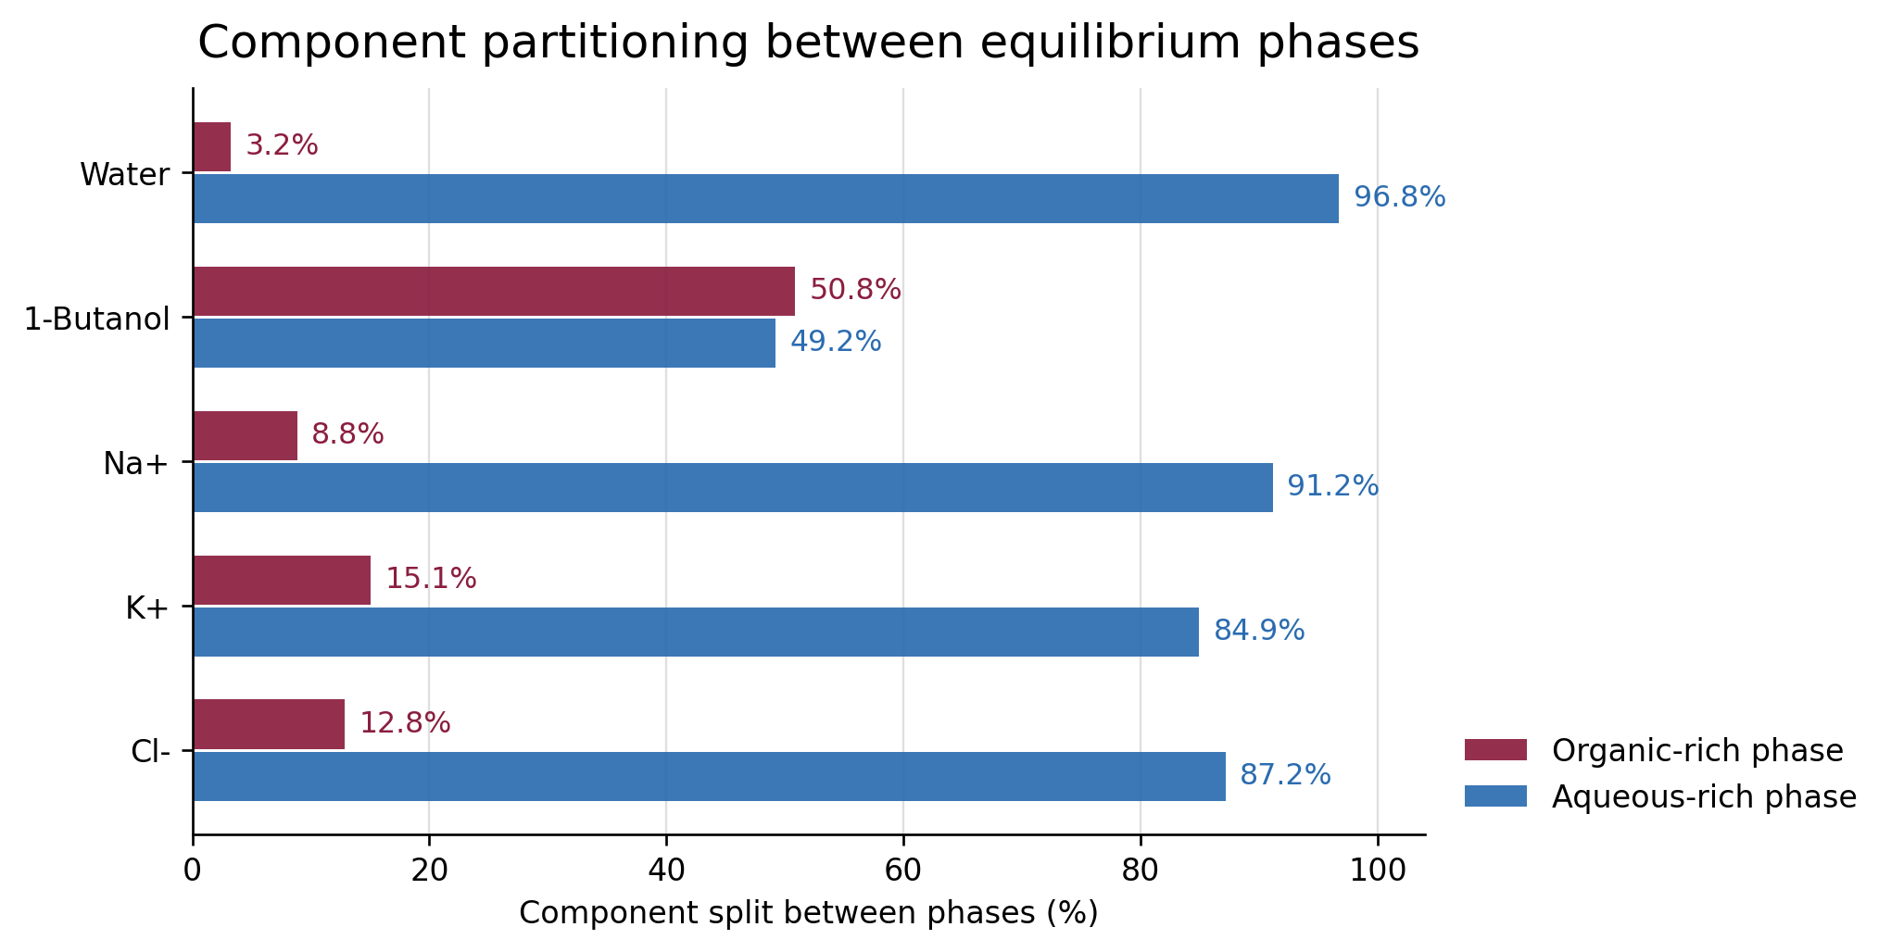
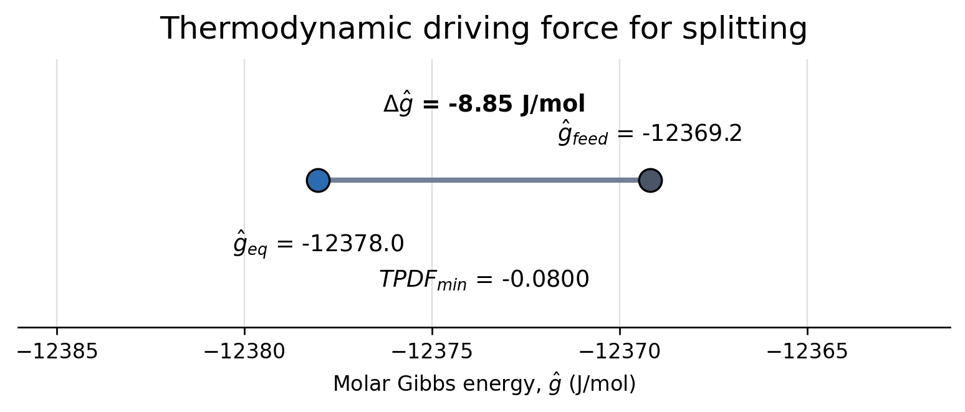
Case Study: LLE of Water + 1-Butanol with NaCl/KCl

Slide 16
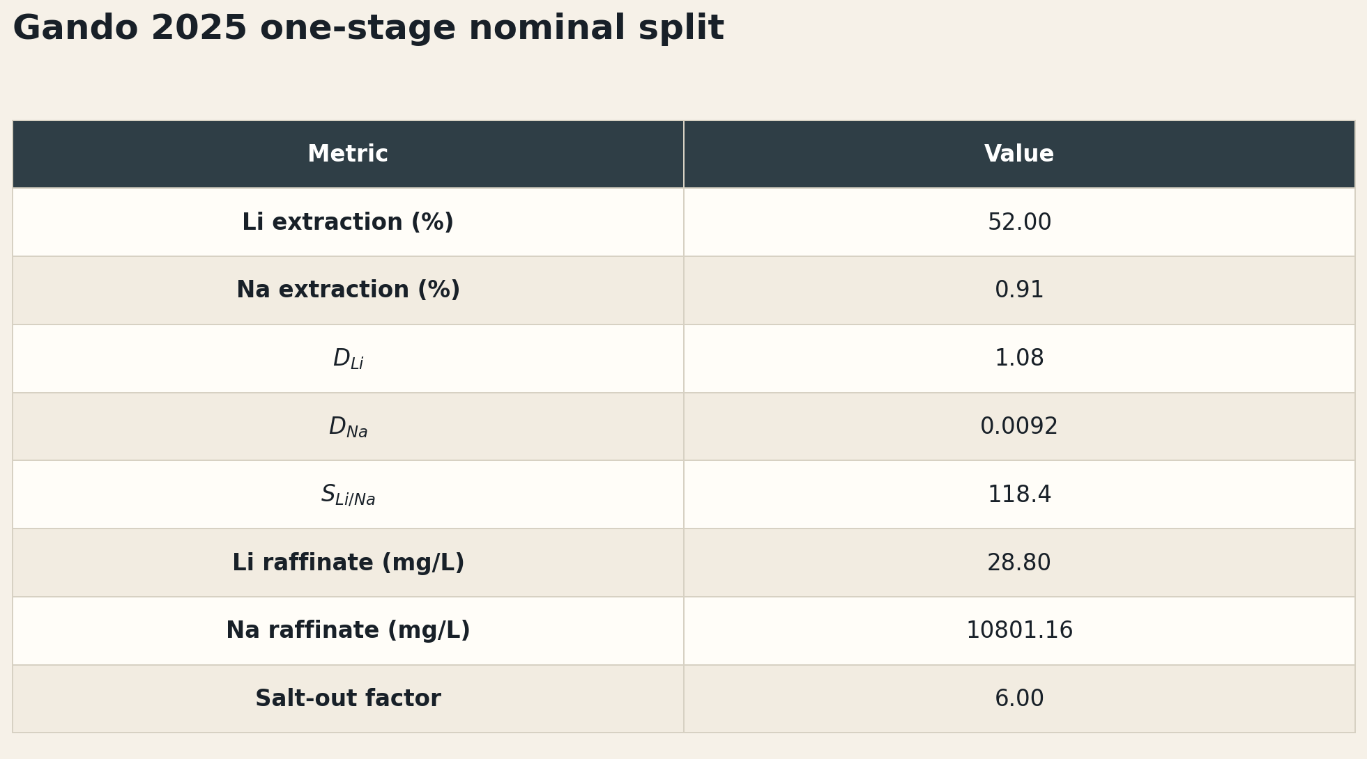
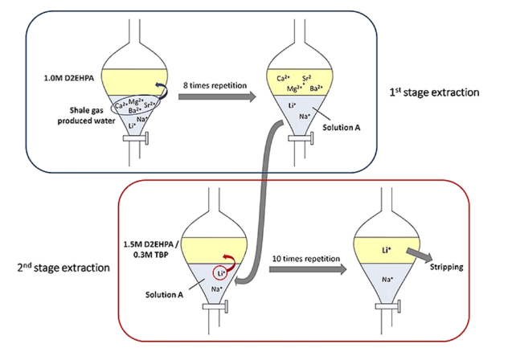
Case Study: 2nd stage extraction of Li+ from Na+

Slide 17
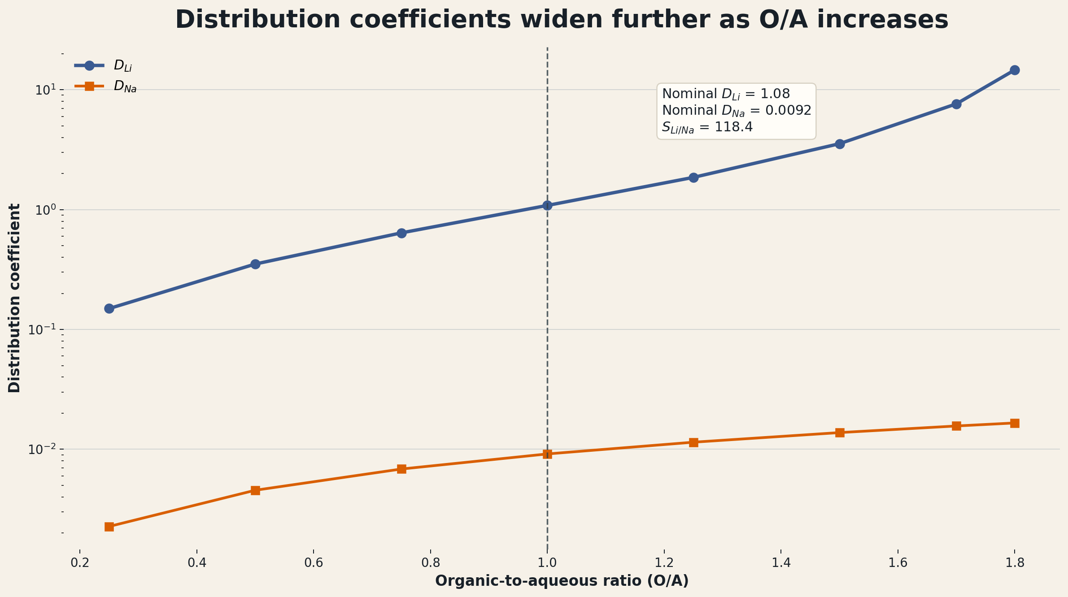
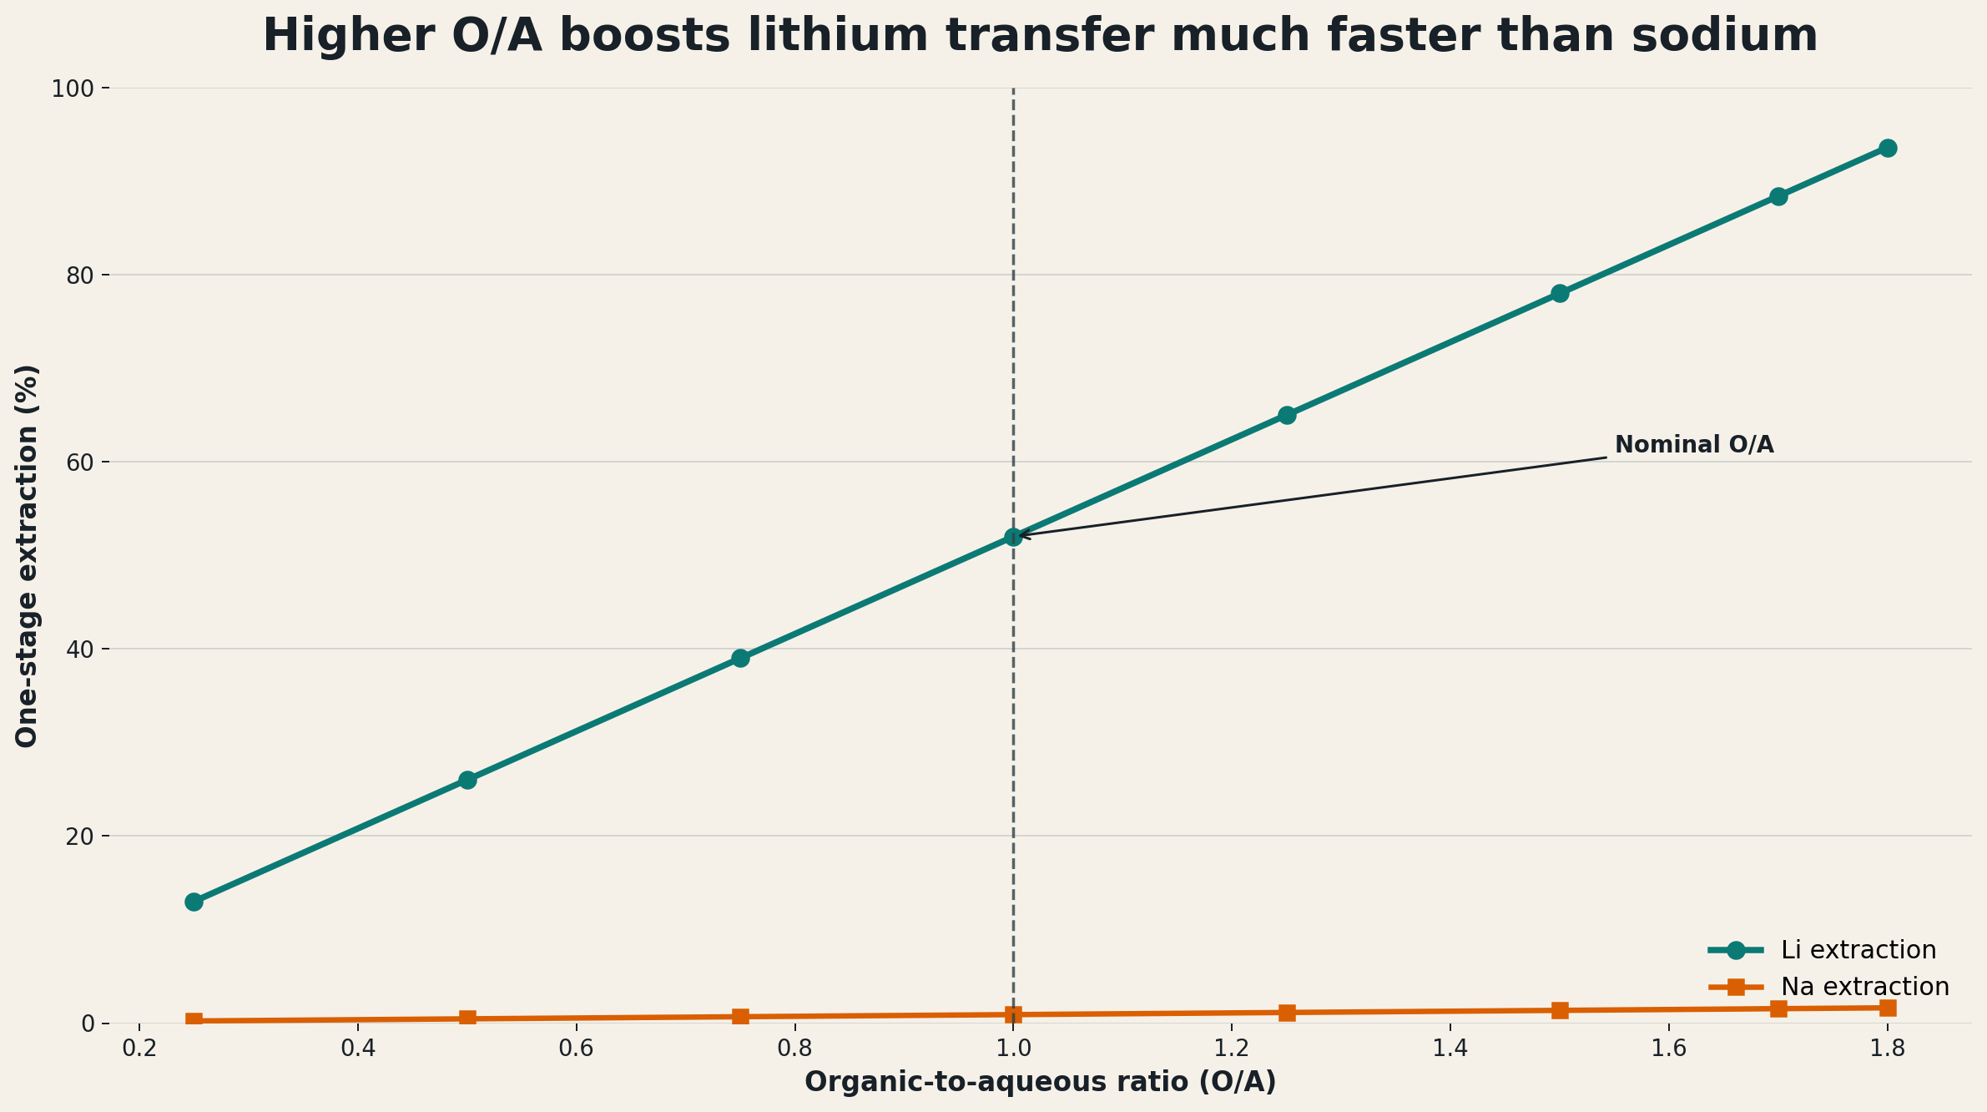
Case Study: 2nd stage extraction of Li+ from Na+

Slide 18
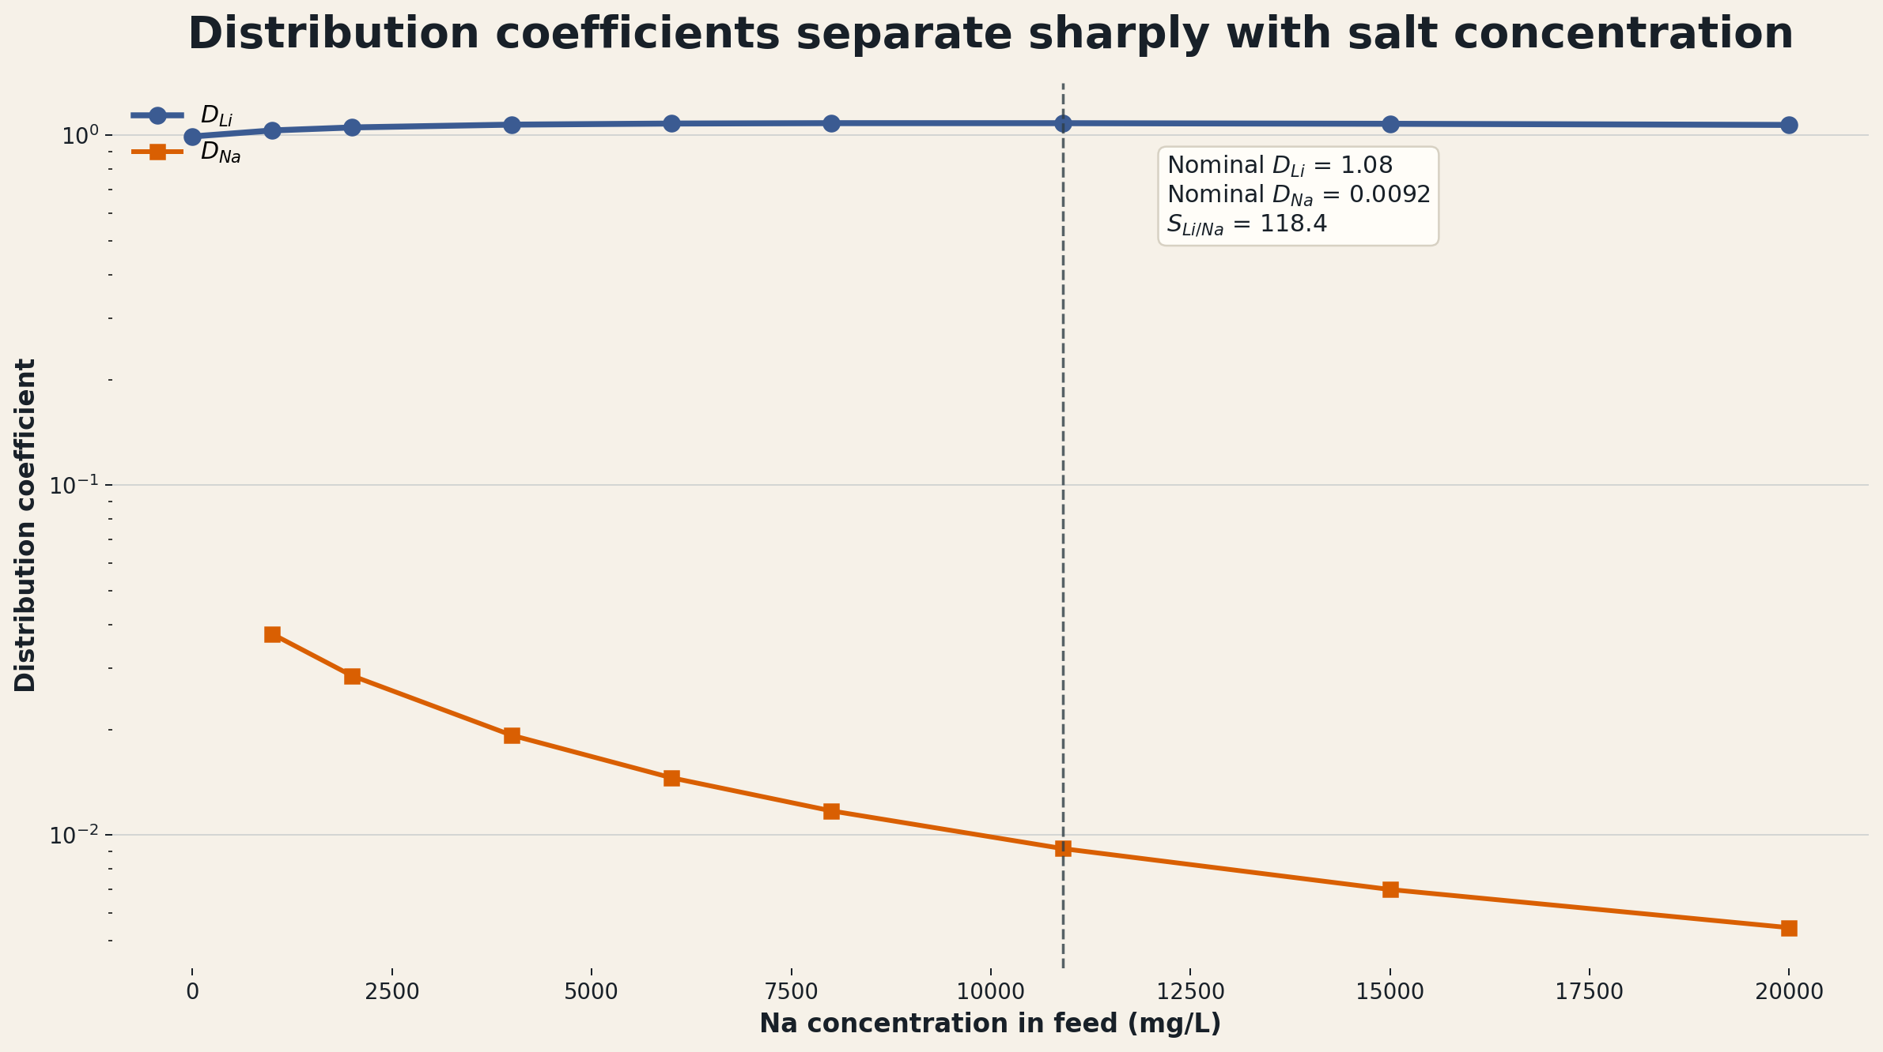
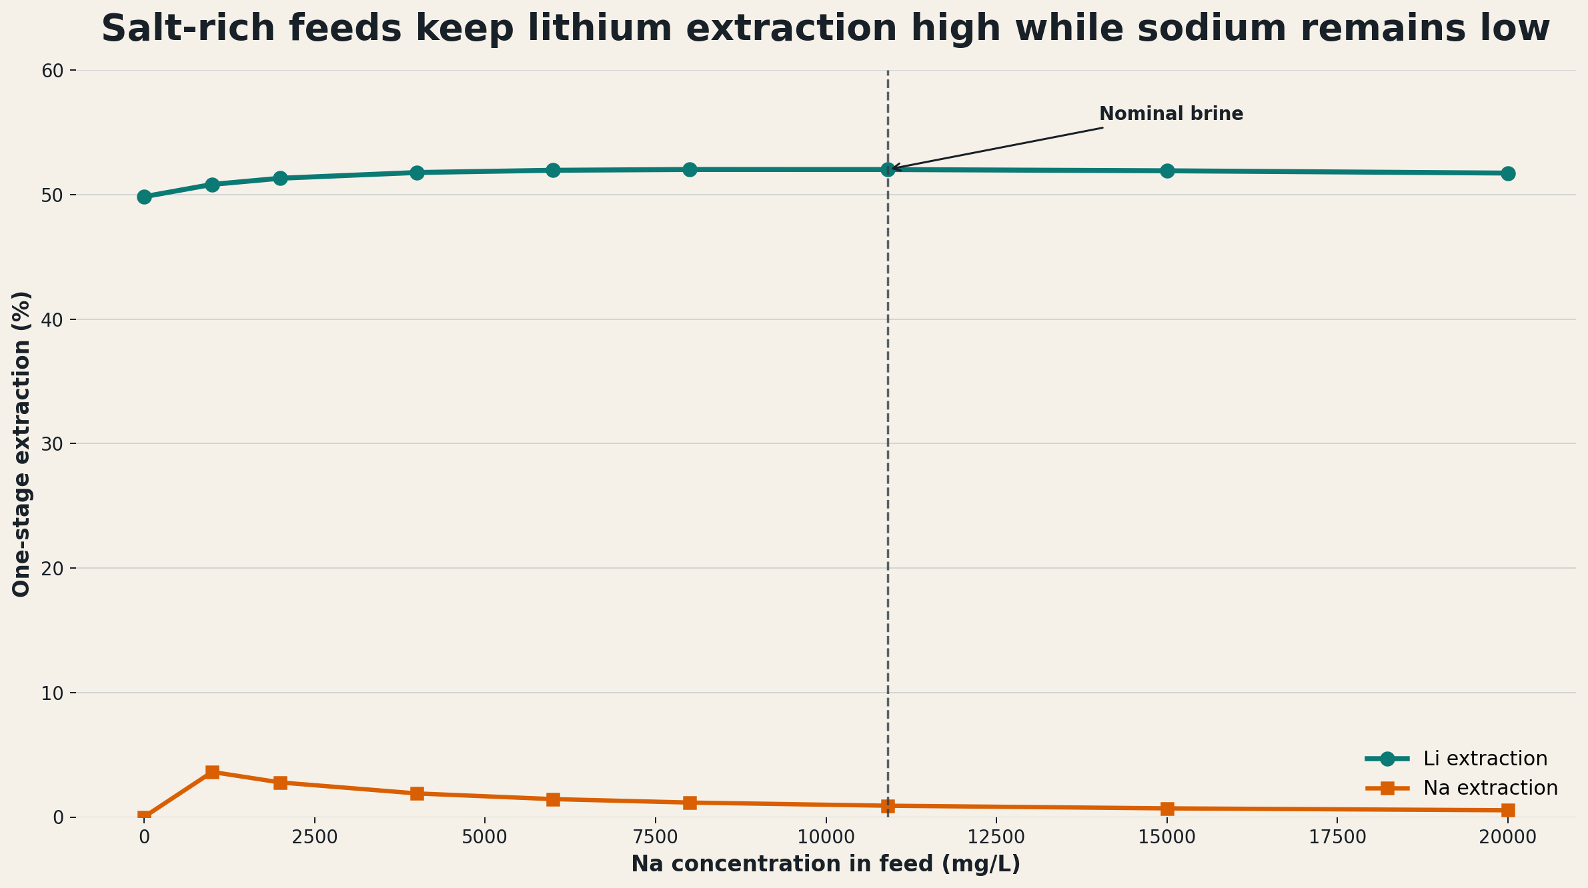
Case Study: 2nd stage extraction of Li+ from Na+

Slide 19
ePC-SAFT Integration into PrOMMiS
pcsaft-pse provides the interface layer between ePC-SAFT and the IDAES/PrOMMiS modeling stack, translating process inputs such as lithium concentration, sodium concentration, extractant concentration, and O/A ratio into stage-level chemistry outputs.
A representative operating window is sampled with the detailed chemistry model to generate stage data, and those results are used to train an algebraic surrogate for key solvent-extraction quantities such as lithium, sodium, and chloride distribution coefficients.
The surrogate is embedded directly into a PrOMMiS solvent extraction stage, where the model uses the predicted distribution coefficients to calculate phase transfer and outlet compositions through the process mass-balance equations.
This workflow makes the detailed chemistry usable in larger process studies and optimization routines, because `PrOMMiS` can vary feed conditions and operating variables while evaluating a fast surrogate instead of repeatedly solving the full chemistry model.

Slide 20
Tasks to Complete / Currently in Progress
Continue to work on validating current working example
Showcase full optimization capabilities while using integration tool
Move from partition coefficient to distribution coefficient
Move pcsaft-pse into the PrOMMiS Project as a repository for easy install and access
Standardize the current API to better match IDEAS/PrOMMiS coding standards
Generalize notebook tutorial to showcase any given composition and varying concentrations can be used
Solidify the surrogate model methodology and best practices
Showcase new and improved tutorial with the given revisions

Slide 21
Project Timeline
04/26
Finish Jupyter notebook tutorial showcasing PC-SAFT – PrOMMiS integration
Ensure its usable for a generalized use case, be it Lithium Extraction, other critical minerals, various salt mixture compositions and solvent mixtures
06/26
Develop a working flowsheet in PrOMMiS utilizing the PC-SAFT integration tool that showcases a novel improvement and understanding of Lithium Extraction from Produced Water that increases confidence in a future adoption of DLE technologies at relevant produced water sites
Finish the first draft of the manuscript from this research and novel contribution
08/26
Begin to build a potential full PC-SAFT model capabilities directly within the IDAES ecosystem both for critical mineral research as well as other various thermodynamic modeling needs
09/26
Submit manuscript for ePC-SAFT aided Lithium Extraction from Produced Water manuscript
Work on Dissertation document in preparation for graduation in 12/26

